Slide 1
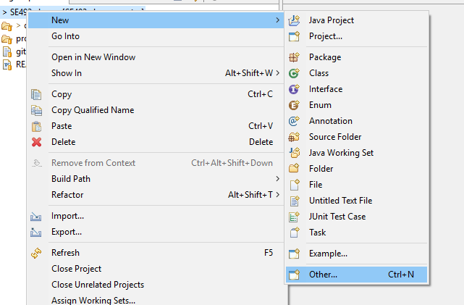
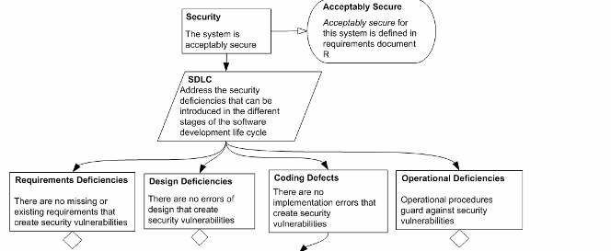
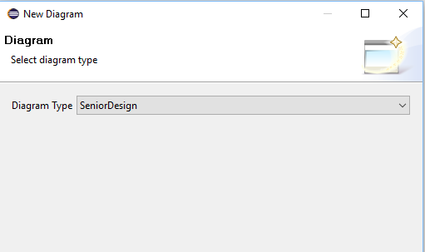
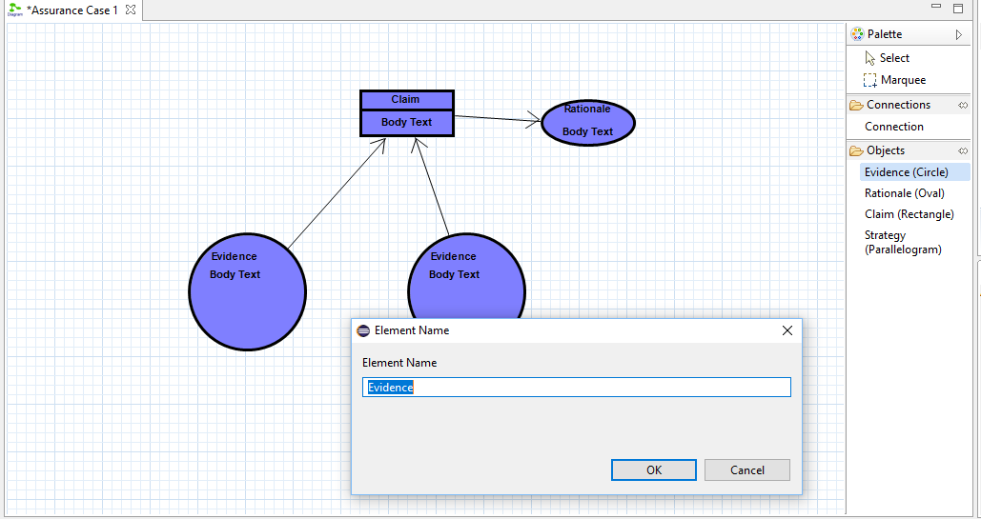
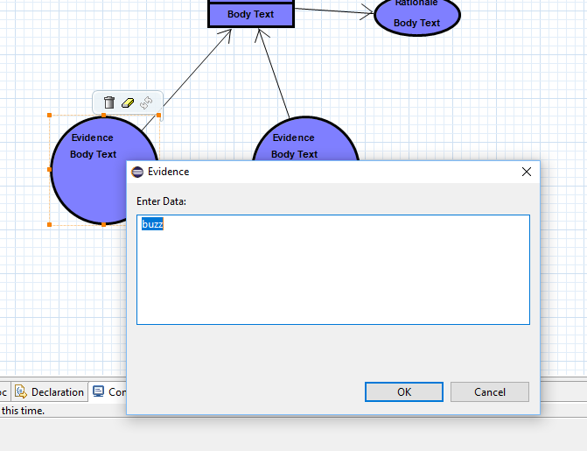
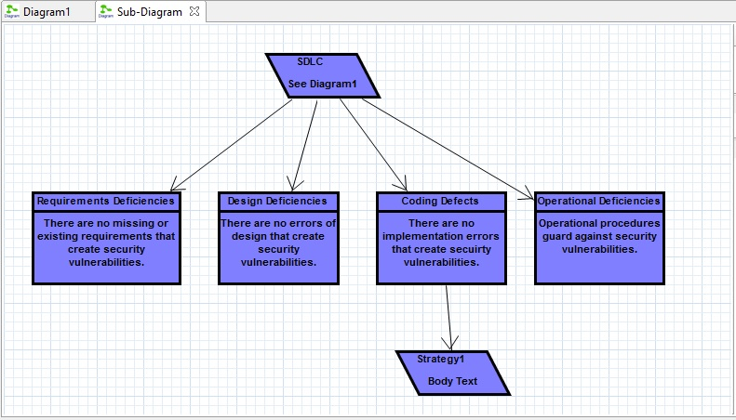
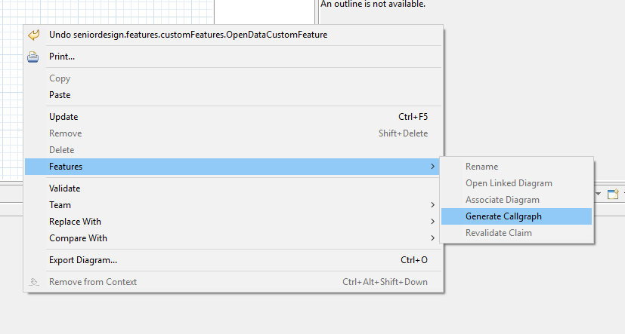
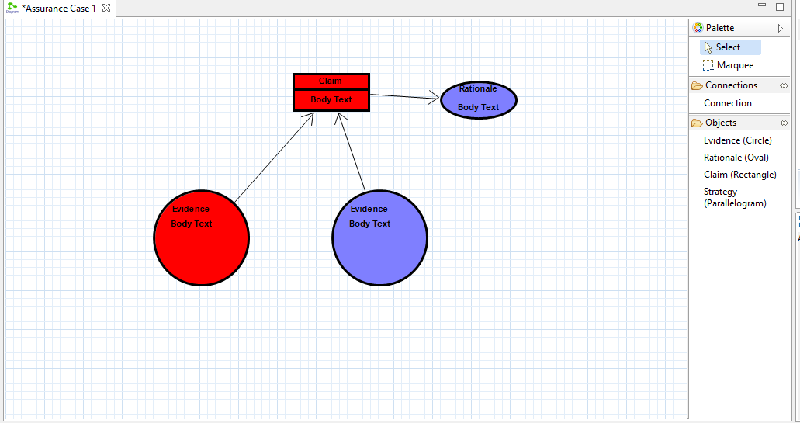
Security Assurance Case Design Tool Team Dec1718 John Koehn, Brandon Huegli, Jordan Lawrence Client/Advisor: Dr. Lotfi Ben-Othmane
Project Description and Goals
Problem
Ensuring security requirements are meet between software versions is time consuming
Solution
Create an easy to use security assurance diagram creator that gives visual feedback when claims are potentially invalid between software iterations.
Requirements
Functional
1. Add/Remove graphical elements to assurance case diagram
2. Multiple graphical elements
Case Claim
Evidence
Edges
3. User Interaction with elements
Move elements
Edit Text
Connect elements
4. Connect graphical elements to function entry points
5. Visually alert user when claim and test are potentially no longer valid
6. Save/Load diagrams.
Non-Functional
1. Visually Pleasing and Professional Interface
This software, while a school project, is hypothetically useful to companies that expect a certain level of professionalism.
2. Simple, easy to use
This software is intended to replace and improve on existing processes, so it must be better, easier to use, and faster than existing products.
3. Secure and bug free
Security assurance cases represent the security of other software, and so compromises or bugs in our program can expose risks in unrelated code.
A Quick Look:
Uses
Intended as an open source project (released on Github publicly)
Potential users include companies and professionals that use assurance cases in their development processes.
Projects that this might benefit are mainly security sensitive, like software that deals with financial transactions or government mandated requirements.
Design and Technology
Graphiti
Designed to build diagram/chart based applications
Works as a Java based Eclipse plug-in
Wala
Java library that supplies classes for generating and using call graphs.
Supports Java (source/binary) and Javascript (standalone/html embedded).
JGit
Java library that allows connection to Git repository through a config file
Created our own Java and JavaScript language parser to get methods changed based on Git diff information.
Testing
Created bi-weekly sprints with Dr. Othmane
Weekly, reported progress and get input
Post sprint, we gave a demo to Dr. Othmane
Dr. Othmane provided feedback to ensure product follows his vision/requirements

